Slide 1

Swami Keshvanand Institute of Technology, Management & Gramothan, Jaipur
Department of Computer Science and Engineering
Industrial Training Presentation
On
Event Management
Submitted to:
Dr. Megha Gupta
Assistant Professor, IT Department
Presented By: Chetan Singh & …………………Aman Sharma
Reg. No.: B230394 & B230847
Semester : 3rd
Session: 2024-25

Slide 2
Event Management Website E-manage
A platform designed to offer comprehensive event management services, providing users with tools to organize and manage events seamlessly, from weddings to concerts.

Slide 3
Purpose/Objective of the Project
Objective: To create a user-friendly, responsive website that allows users to organize events by offering services like venue selection, food arrangements, entertainment, and more.
Target Audience: Event planners, individuals, and businesses.

Slide 4
Technology/Platform Overview
Frontend Technologies:
- HTML, CSS for layout and styling.
- JavaScript for interactive features.
- Swiper.js library for responsive image sliders.

Slide 5
Implementation/Methodology
Header Section: Sticky navigation bar with links to various sections.
Responsive Design: Ensures smooth user experience across all device types.
Interactive Features: JavaScript-powered popup for form submission and Swiper for image sliders.

Slide 6

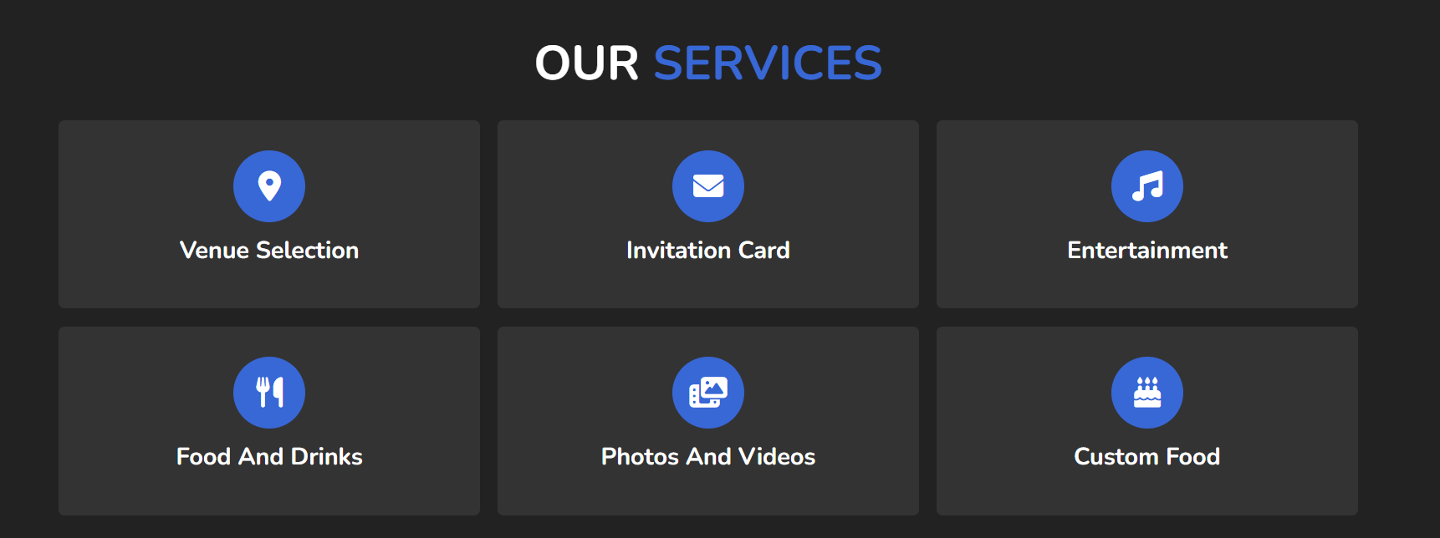
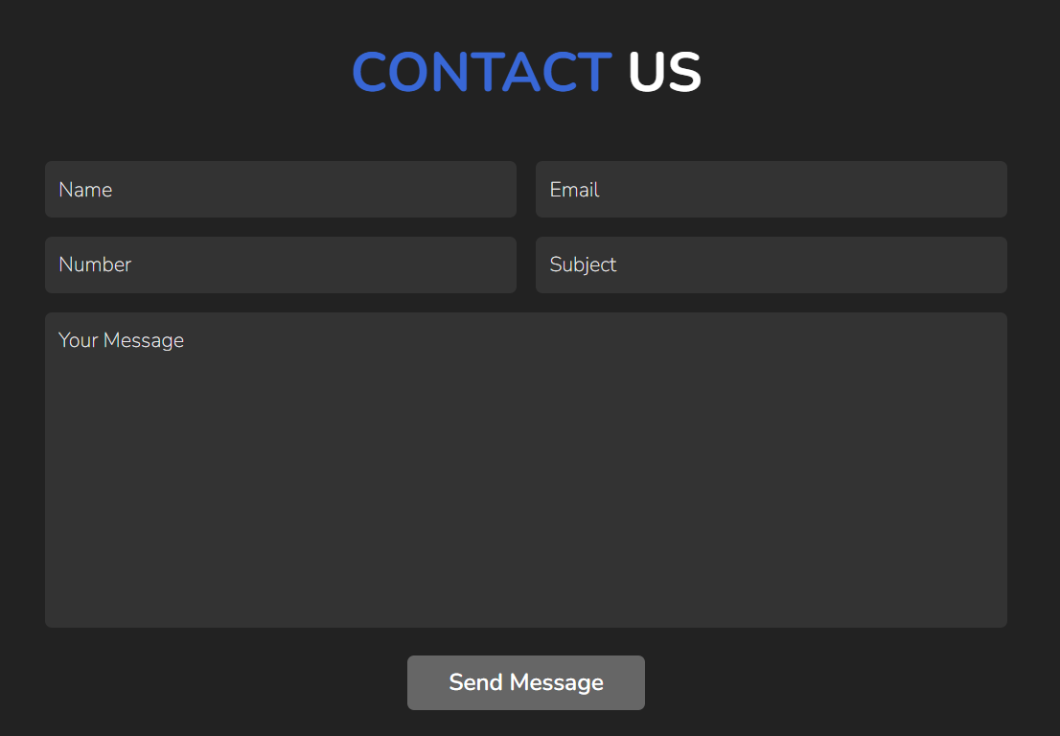
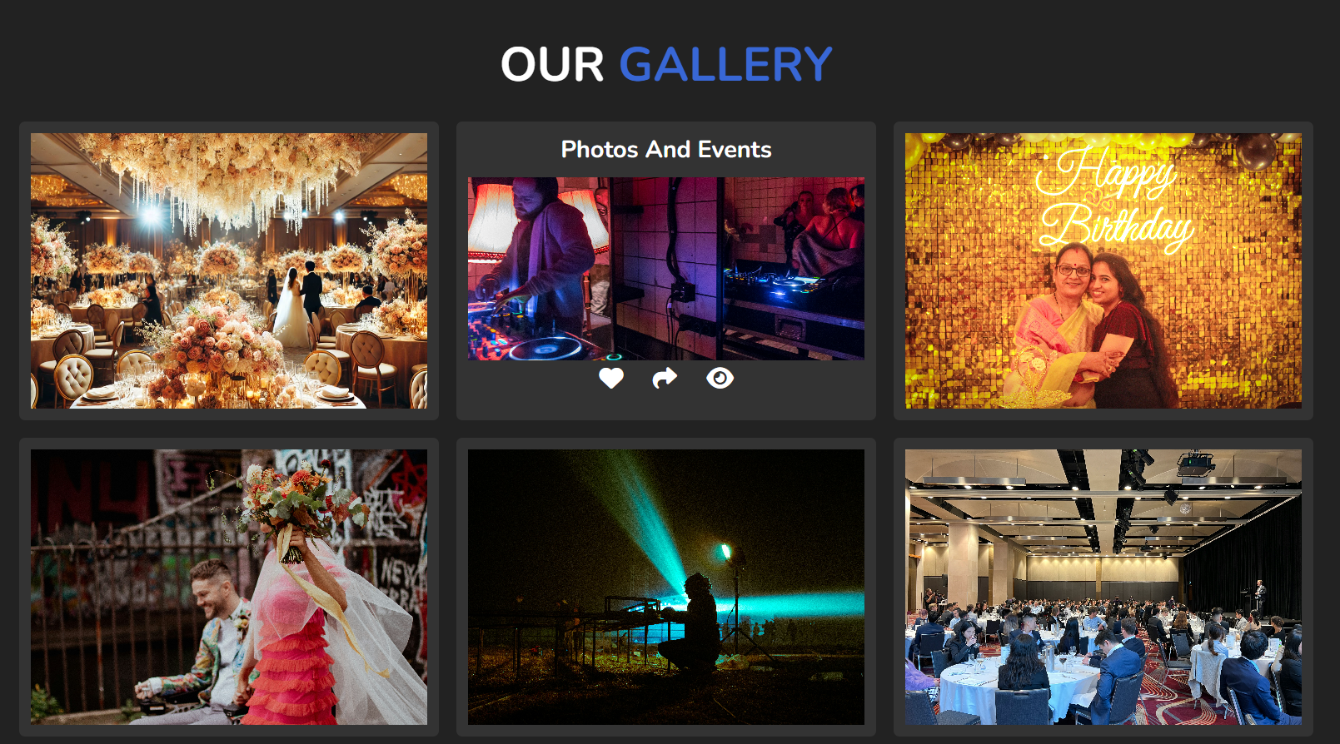
SCREENSHOTS

Slide 7
Future Work
Enhanced Functionality:
- Integrating backend for user accounts and booking services.
- Adding more payment gateway options.
- Expanding service categories for different types of events.

Slide 8
Conclusion
Summary: This website lays the foundation for a comprehensive event management system.
Future Potential: The project has potential for growth in user engagement and service scalability.

